Slide 1
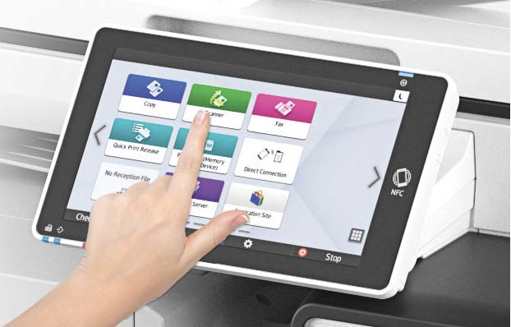

Managed Print Services
MFP/SOP Cleaning Best Practices
March 2020
Prepared by:
Rachelle Paulino

Slide 2
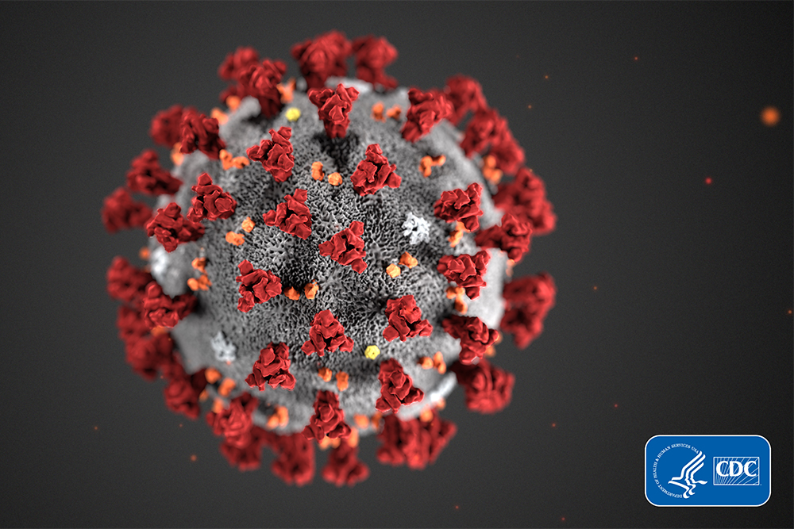
Recent Concerns
In light of the recent concerns with the COVID19 Coronavirus, everyone wants to know how best to clean their MFP screens and operation panels.
For generally information regarding the Coronavirus (COVID‐19) visit the CDC’s website:
https://www.cdc.gov/coronavirus/2019‐ncov/about/transmission.html

Slide 3

Recommendations
What I Should Avoid?
Avoid anything that contains:
Bleach
Ammonia
Other harsh cleaning solvents
The touch screen could eventually become clouded and require replacement.

Slide 4
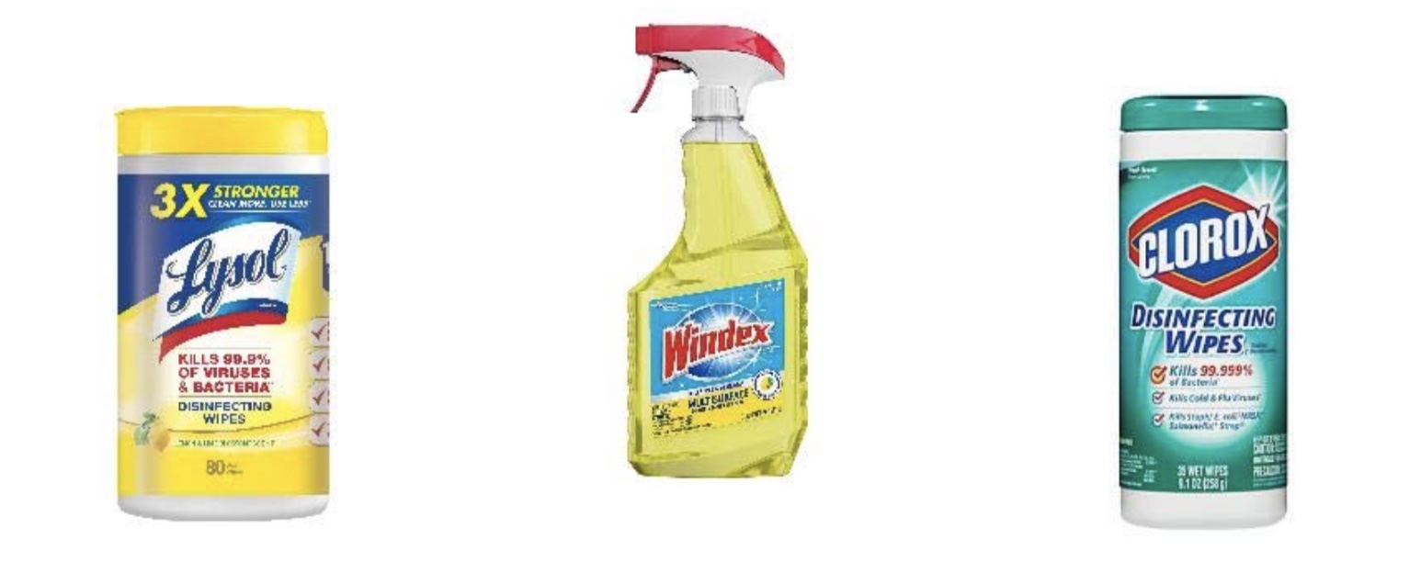
Recommendations
What Can I Use?
Most types of anti-bacterial wipes or sprays

Slide 5
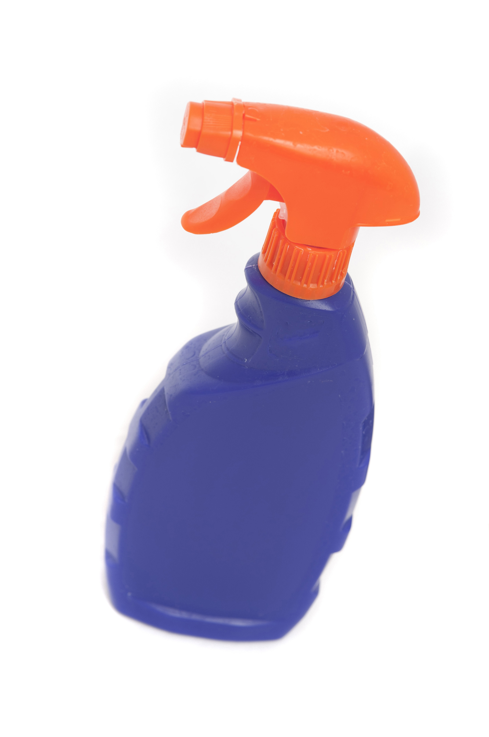
Recommendations
Using a Spray Bottle?
Lightly moisten a cloth and gently wipe down the screen and panels
A lint-free microfiber cloth is recommended – Avoid paper towels as they may scratch
DO NOT spray directly on the device’s surfaces or components, as getting liquid inside the device could damage the internal components

Slide 6
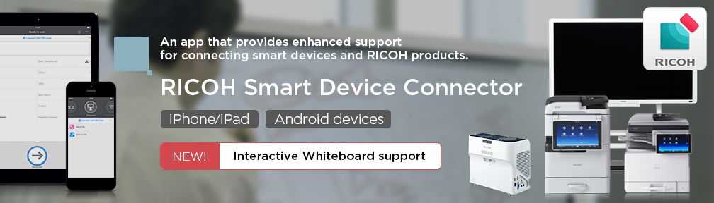
Ricoh Smart Device Connector
Ricoh’s Smart Device Connector allows you to your device panel from a smart phone or Tablet
Copy
Print
Scan
Fax

Slide 7
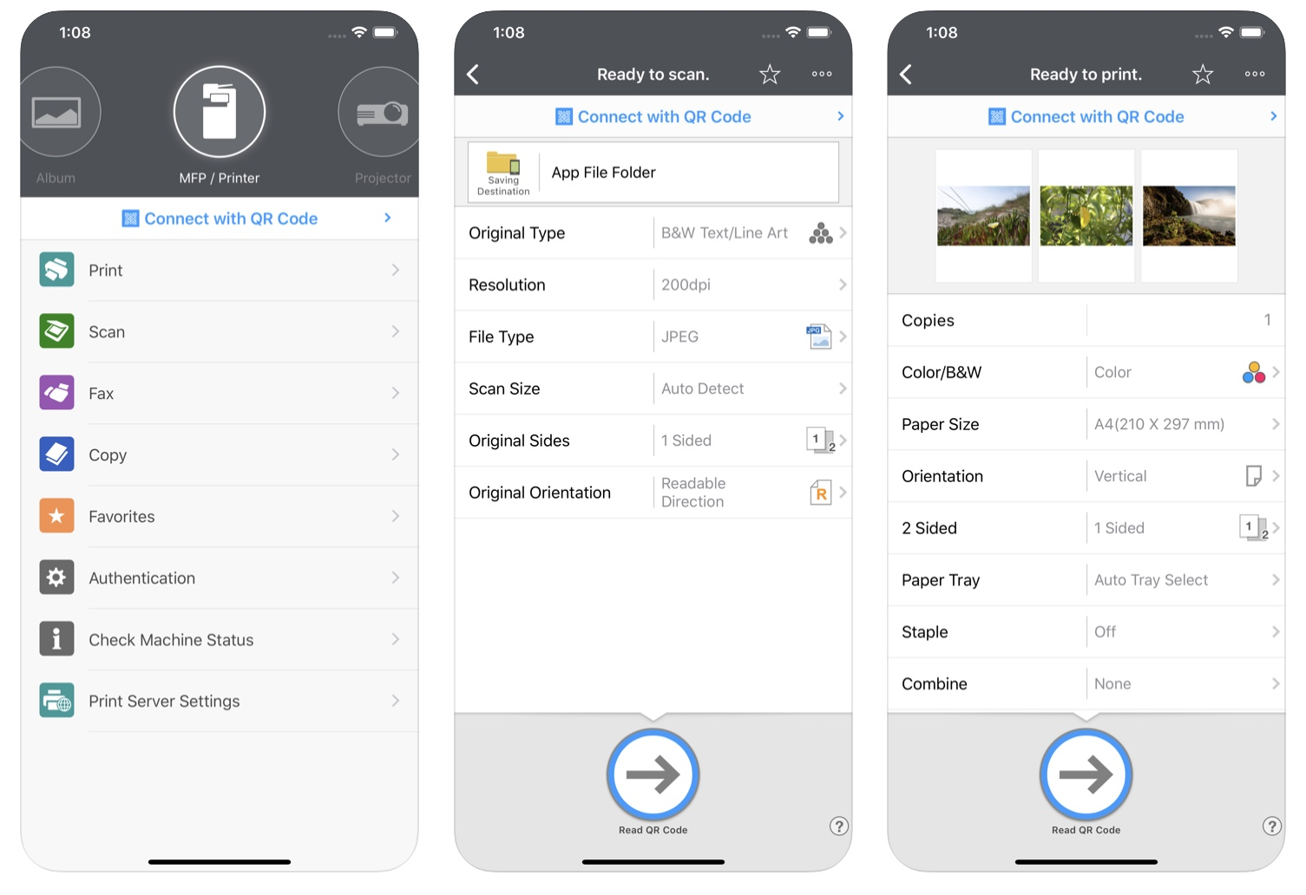
Ricoh Smart Device Connector
Copy settings can be specified
Number of copies – B&W or Color
Simplex or Duplex
Frequently used settings can be saved as favorites

Slide 8


Ricoh Smart Device Connector
Available for free on Google Play and the App Store
For more information, please visit
https://www.ricoh.com/software/connector

